Slide 1
Manga & Anime
Samantha Meza, Jessica Camacho, Thomas Ye

Slide 2



Introduction
What are Manga and Anime?
Notes:
Anime are animated videos of Japanese series typically of Manga. While Manga are comics or graphic novels from Japan. Animes usually originate from manga so we would expect there to be a strong relationship between the success of one and the other.
Typically animes are done in full color in 20-30 minute segments while Manga are usually black and white and have a much wider variation of chapter & volume length.
Since the plot of the anime would typically stay the same, usually the same scene or plot points would show up in the anime that have already showed up in the manga as noted above.

Slide 3
About the Datasets
Two datasets - Anime and Manga
Datasets were merged on the Title
Data will be outdated - from 2015
Notes:
Manga dataset not good
Not every manga and anime is included, after merging the datasets we were left with a little over 1000 shows that had both a manga and an anime that matched based off title.
Anime dataset was for 2017, Manga dataset was for 2015
Since the older dataset was for 2015, that’s the newest manga that will be shown
The datasets were merged based off of titles, resulting in discarding the titles that didn’t have a manga and or anime.

Slide 4
Project Overview
3 Major Questions
Are there differences in the anime ratings based on the genre?
Does the length of the manga play a role in the success of the anime?
Is there a relationship between the success of the manga and the anime?

Slide 5
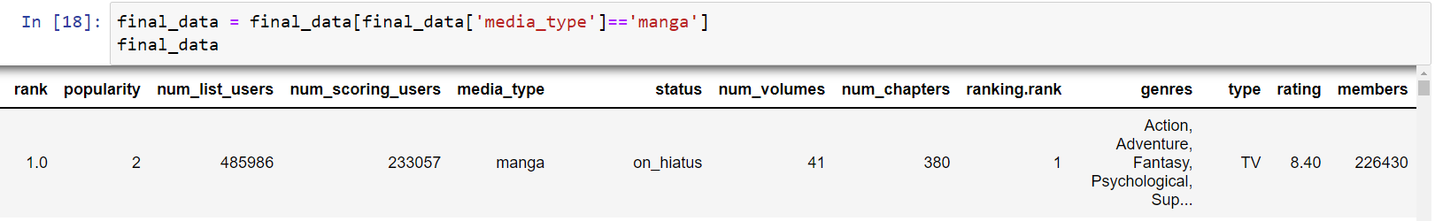
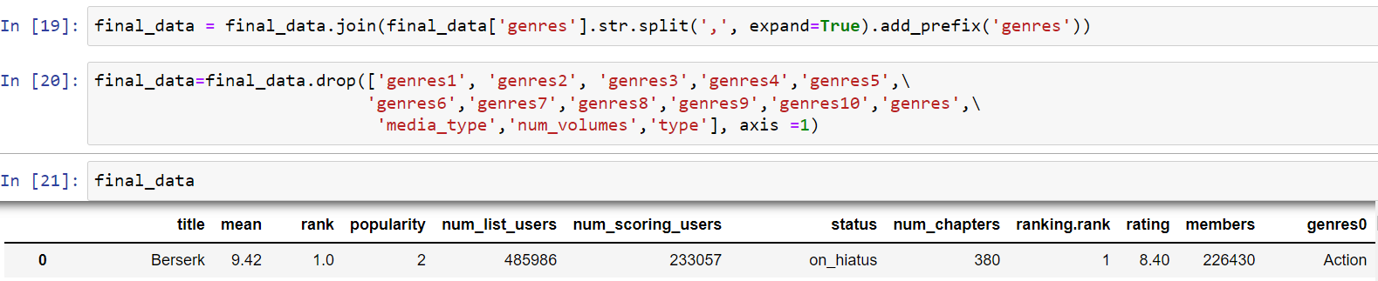
Data Cleaning
Notes:
Some filtering to get what we wanted. A lot of the times we had light novels, comics, one-shots, and other media types. But we just wanted to focus on Manga. In addition to that, many shows have more than one genre but there’s usually a primary genre. We decided to drop secondary genres and just look at the primary genres of each show to evaluate their manga & anime ratings from there.
-sam 5-7

Slide 6
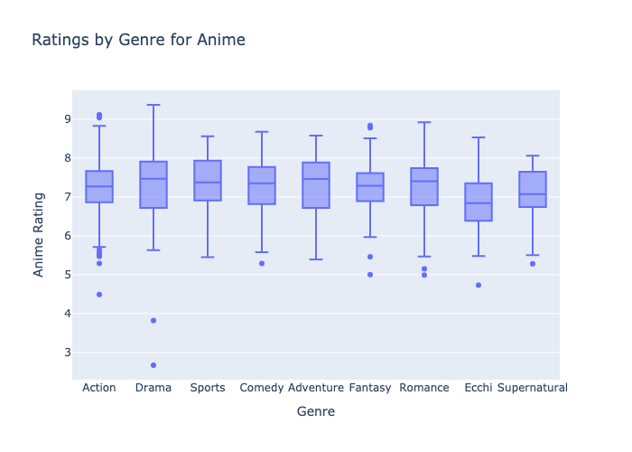
Anime Genre Comparisons
Notes:
This boxplot is showing us that there is small variations between the genres in anime.
Some outliers have less than 1000 voters, resulting in the question of their validity. However, is it not reasonable to cast them out because then our dataset would only include popular shows.
Drama and romance have the most variation
We can only assume that there were titles that were merged together without any relation to one another. Ex: Kokohaku, listed under Drama and is the lowest outlier. It is a 40-second homemade animation clip on youtube. It was put onto myanimelist.com for some reason, which is a problem with our dataset.

Slide 7
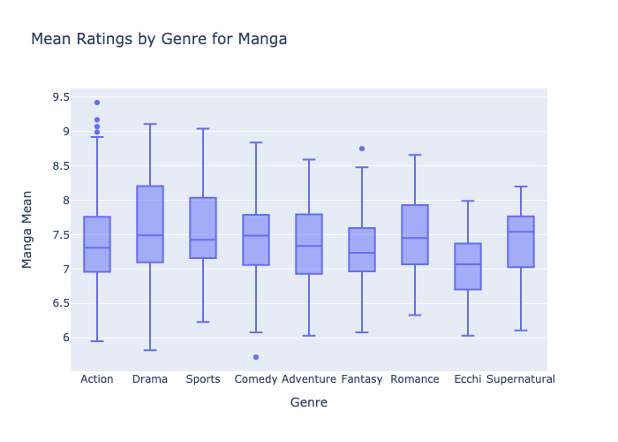
Manga Genre Comparisons
Notes:
when compared to anime, manga has less outliers and is more consistent; however, the ratings are in means making the manga data look more consistent than the anime data.
for both the manga and anime, drama appears to have the most variability.
the range for the manga is about 5.9 - 9.1 the range for the anime is about 5.5 - 9.3

Slide 8
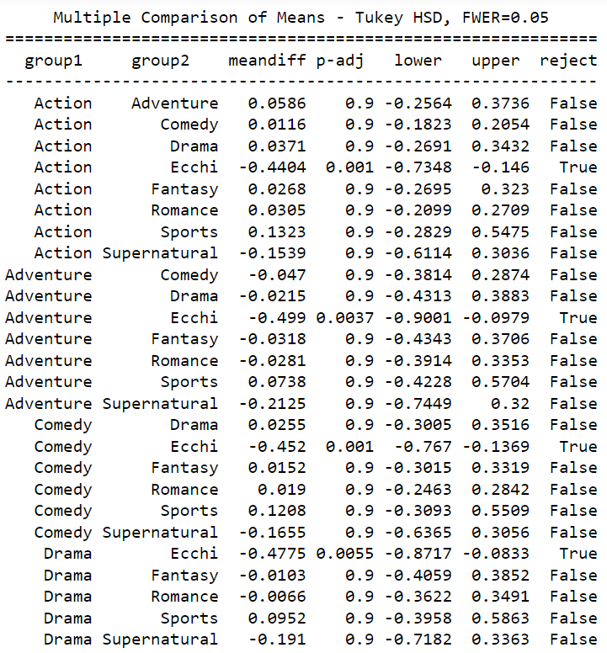
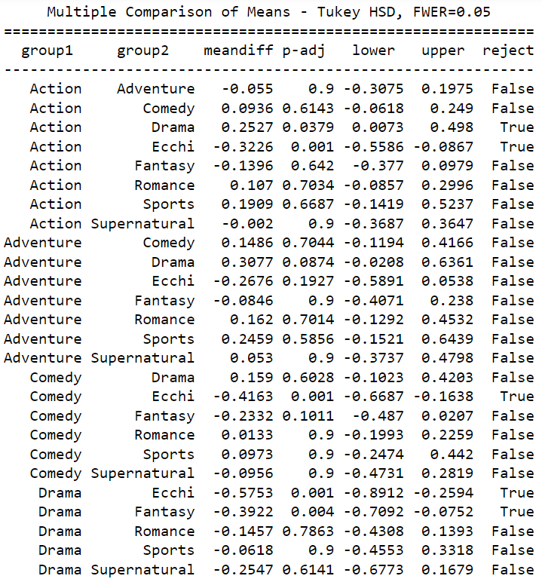
Anime
Manga
Notes:
For both anime and Manga. The ecchi genre seems to have significantly lower ratings relative to the other genres. This makes sense because this genre is for people with trash taste, but moreso because it’s in the nature of the genre. They’re usually relatively low-budget, low-story, and appeals to the male fantasy.

Slide 9
Hypothesis Development
Hypothesis: If the mean rating of the manga is high, then the rating of it’s anime will be high.
Null Hypothesis: The mean rating of the manga is high and the rating of the anime is going to be the same or less than manga.
Alternative Hypothesis: The mean rating of the manga is high and the rating of the anime is going to be higher.
Significance Level: 0.05

Slide 10
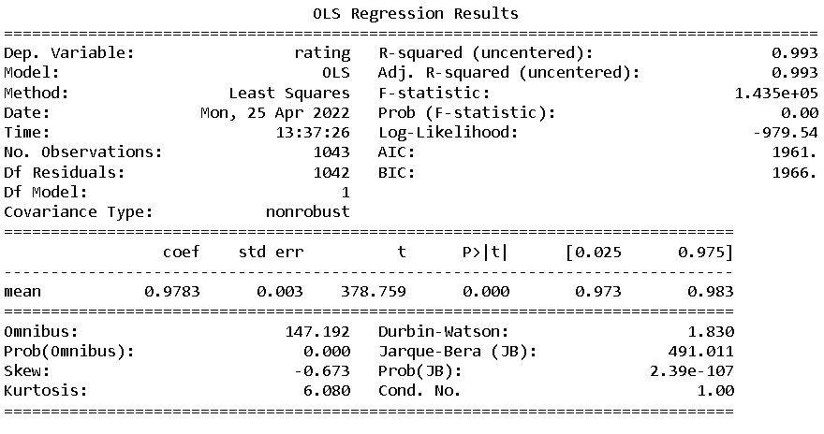
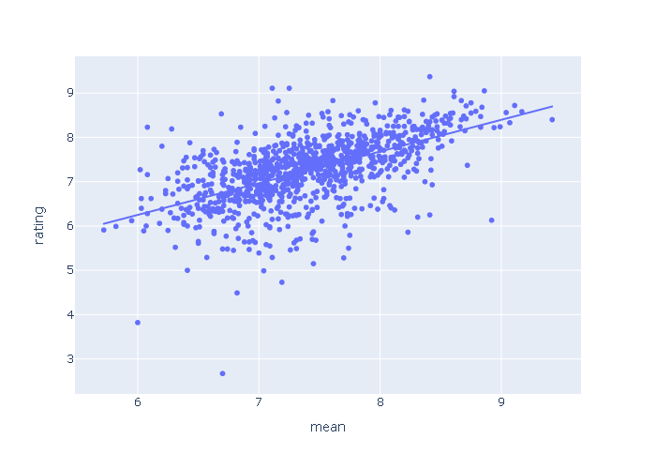
The Relationship Between the Ratings of Manga & it’s Anime’s Ratings
Notes:
Since the p-value is less than 0.05 we can reject the null hypothesis.
The R-squared value is 0.993 showing that our dependent value (rating of anime) can be explained mostly by our independent value (mean of manga).
Summary: 99.3% of the variability of the ratings of anime can be explained by the variability of the mean of the manga. This is in line with our hypothesis, showing us that when the mean of the manga is high the rating of the anime is also high. Manga most commonly comes before it's anime, and the anime is usually dependent on the success of the manga.

Slide 11
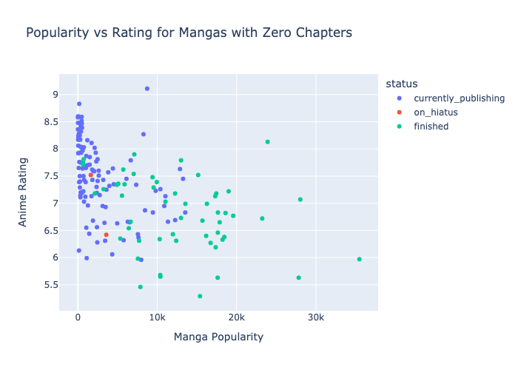
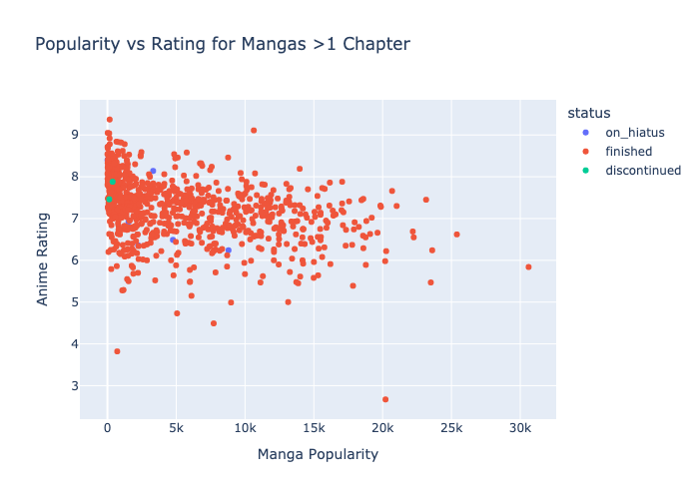
The Relationship Between Manga Length and Anime Rating:
Chapter Length Exploration
Notes:
JESSICA - Using a proxy for manga mean - popularity. We saw that those mangas that had zero chapters did not have zero chapters currently. The number of chapters being marked as zero in our dataset may be due to the point in time this data was captured in 2015 - it may be better to not put in the number since the status is not known at the time (and as you can see with the status). In general we view that mangas that keep get published are popular and tend to have higher ratings for their respective anime.
We could have segmented on status, but we saw that there were mangas who had a status of “on hiatus” that was shared, so we choose to analyze only mangas with chapters for our further analysis.
One of the things that we were interested in exploring was the relationship between the manga length (explored in chapters) and its respective anime rating. The first something we noticed early on in our data set was that the chapter length column looked a little strange. We had some mangas listed as having zero chapters and some mangas that had too many.
And we see we see one of the potential reasons why mangas have zero chapters listed as the number of chapters maybe because they have an uncertain status like currently in publishing or on hiatus. From the first visualization on the left we see this is consistent with her previous scatterplot which shows that mangas that are popular keep getting published and typically a higher anime rating.

Slide 12
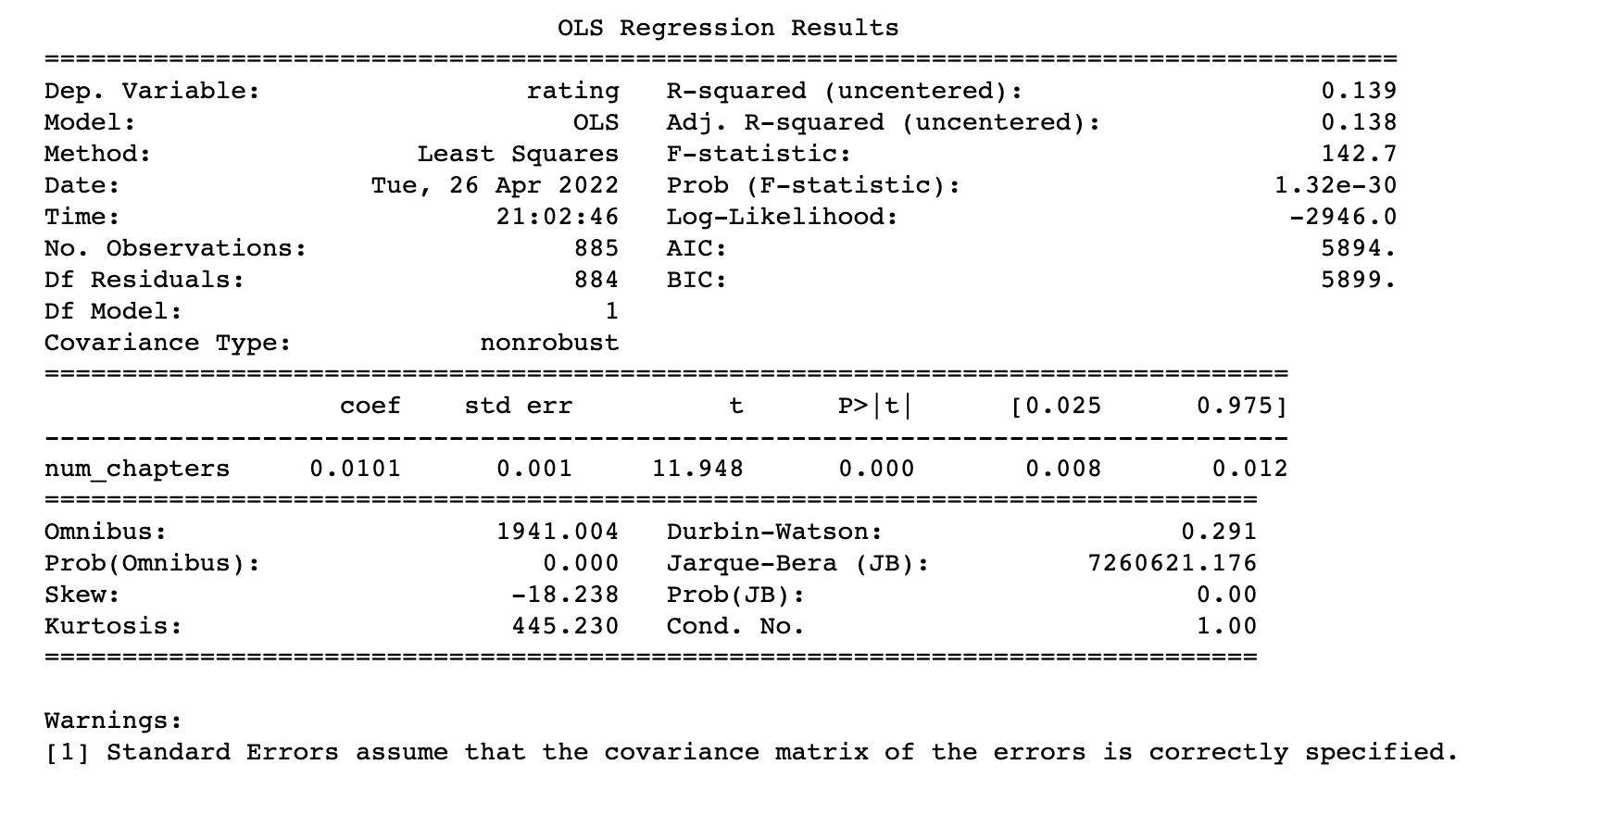
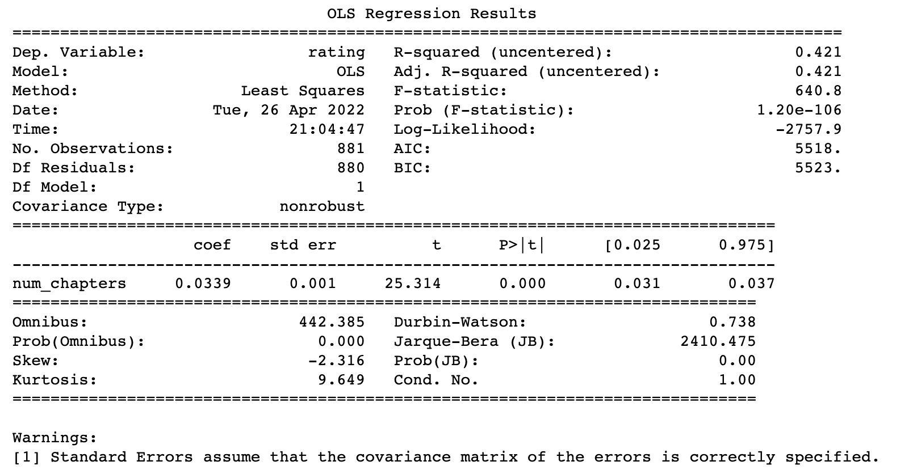
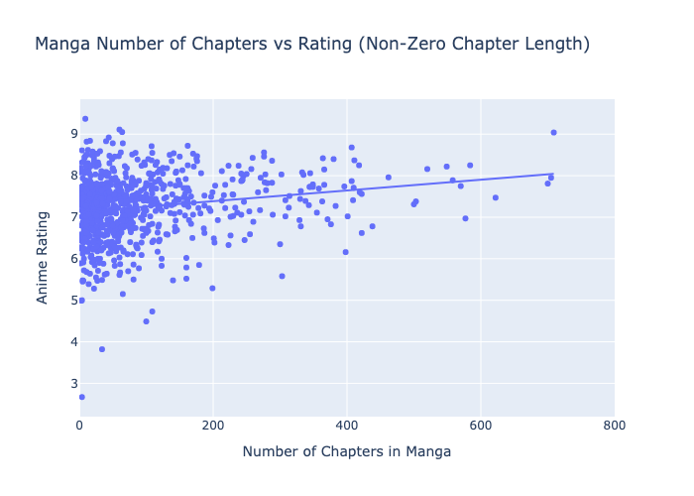
The Relationship Between Manga Length and Anime Rating
Mangas with over all non-zero chapters
Mangas less than 1000 chapters
Notes:
JESSICA- We see there is a relationship between the number of chapters a manga has and the anime rating, but this alone is a poor predictor for the anime's success. When we remove the extreme outliers at both ends of the spectrum (0 and over 1000 chapters) there is a jump in the R^2 value from 13.9% to 42.1% and although removing natural outliers is a bad practice, we see that despite this change, the relationship of predictability remains to be a poor predictor alone.
We do acknowledge that our data is heteroskedastic since manga with a high amount of chapters isn’t as common.

Slide 13
Project Overview Pt. 2
3 Major Questions
Are there differences in the anime ratings based on the genre?
Yes!
Does the length of the manga play a role in the success of the anime?
Yes!
Is there a relationship between the success of the manga and the anime?
Yes!
Notes:
JESSICA - Yes with limitations, only able to find a worst genre.
Length has a low R^2 value but it has a significant P-value.
Yes! The R^2 value is major and the P-value is significant as well.

Slide 14
Summary & Recommendation
There are no discernable differences on anime ratings based on the genre outside of the ecchi genre.
There is a very strong relationship between the success of the manga and the success of the anime.
Our recommendation for studios would be to base their decisions for anime on how the manga is performing.
Notes:
JESSICA-Animes and Mangas generally tend to have a similar average based on genre.
For each show on an individual level, because the relationship is strong, a good predictor on whether or not an anime should be made is whether or not the manga is doing well.
Small caveat being that sometimes ratings don’t necessarily mean profitable. We acknowledge that although the success of the manga is well correlated with the success of the anime. This is in terms of ratings. Lots of shows/books/movies have great ratings but they may not be popular. The inverse is true as well where shows/books/movies have trash ratings but they may be very popular.

Slide 15
Problems Encountered
Num_scoring_users - Some outliers have less than 1,000 voters, resulting in the question of their validity.
Shounen - shows that are designed to go on forever and be highly rated.
Manga dataset - the chapters column is not up to date due to using a dataset from 2015.
Data May be Outdated - Trends in the past may not be applicable to today’s age.
Some Titles may not be relevant to our questions.
Notes:
Some of the titles may not be relevant to our questions because 1) Ex: kokuhaku - was a 40 sec clip on youtube that made it onto myanimelist.com
We can only assume that there might be other Titles with the same issues, and brings the question of myanimelist.com’s validity
Trends are from 1980-2015, decades worth of data, could be applicable to today because it has shown consistency based off sample size. Or maybe it’s not applicable today and we’ll have to do further research to see if the rating of older anime stood against the test of time.
Sam

Slide 16
Future Considerations
Obtaining data for the anime on whether it is publishing, on hiatus, or finished.
Obtaining data from companies such as Crunchyroll & Funimation to create complete & accurate information.
People generally review things that they either really love or really hate - obtaining qualitative data such as written reviews and picking keywords: great, good, alright, ok, bad, horrible.

